Slide 1

Graphical User Interface July 2, 2021

Slide 2
Today’s topics
Review
Graphics
Functions (Ali – this afternoon)

Slide 3
for Loops
Use a for loop when you know how many times:
for i in range(count):
statement
statement
...
Repeats the statements in the body count times.
Notes:
Executes statements in order – NOT repeating each one individually

Slide 4
Control Flow: while Loops
while condition:
statement
statement
...
Repeats the statements in the body until condition is no longer true.
Each time, execute all statements, and then check the condition.
Notes:
Karel can ask some questions about its world / surroundings

Slide 5
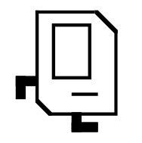
Karel Knows 4 Commands
move()
turn_left()
“functions”
put_beeper()
pick_beeper()

Slide 6
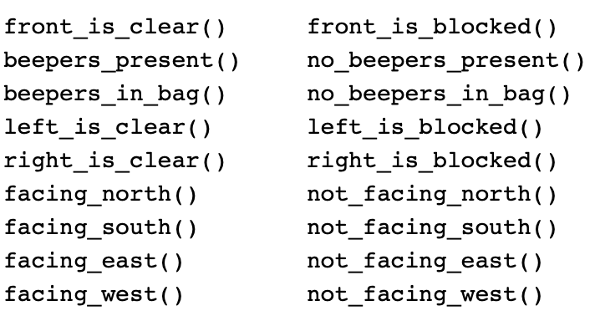
Possible Questions
This is taken from the Karel Reference.

Slide 7
if/else Statements
What if we want to do one thing if some condition is true, and another otherwise? We can add an else statement:
if condition:
statement
statement
...
elif condition:
statement
statement
else:
statement
statement
...

Slide 8
Top-Down Design - Decomposition
Start from a large task and break it up into smaller pieces
Ok to write your program in terms of commands that don’t exist yet
Goal: make our programs easily readable by humans
Commenting
Decomposition
E.g. Going to the moon

Slide 9
Using Python
Python must be installed and configured prior to use
One of the items installed is the Python interpreter
Python interpreter can be used in two modes:
Interactive mode: enter statements on keyboard
Script mode: save statements in Python script/program

Slide 10
Create, Modify, Use
# Create a variable, of type int
# called age with the value 31.
age = int(input(‘What is your age: ‘))
# Modify age to be one greater.
age = age + 1
# Use the value in age (output it)
print(“age is: ” + str(age))

Slide 11

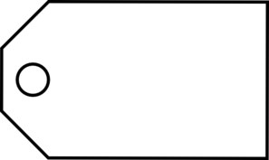
Variable Analogy
num_students = 700
num_students
int
700
name
type
value

Slide 12
input function
num1 = input("Enter first number: ")
input command gets text input from the user
Prints text specified in double/single quotes
Then waits for user input
Here, user input from input is put in a variable (num1)
The user input is considered text, even if user entered a number

Slide 13
All Python objects have a type!
Types
Integers - numbers with no decimals
num_flowers = 5
Floats - numbers with decimals
fraction = 0.2
Booleans - True or False
is_raining_today = True
Strings - collection of characters
myName = ‘Ayca’

Slide 14
Binary Operators
+
Addition
*
Multiplication
–
Subtraction
/
Division
There are others too!
%
Remainder
//
Int Division
**
Exponentiation

Slide 15
Comparison Operators
Operator | Meaning | Example | Value
== | equals | 1 + 1 == 2 | True
!= | does not equal | 3.2 != 2.5 | True
< | less than | 10 < 5 | False
> | greater than | 10 > 5 | True
<= | less than or equal to | 126 <= 100 | False
>= | greater than or equal to | 5.0 >= 5.0 | True
* All have equal precedence

Slide 16
Random Integers
Minimum value
secret_number = random.randint(1, 99)
Maximum value
Minimum and max values are includes

Slide 17
How can we generate graphical programs?
GUI libraries (modules)!

Slide 18
Definition
Graphical User Interface (GUI)
Visual elements that you interact with within applications (windows, buttons, scroll bars, etc.)

Slide 19
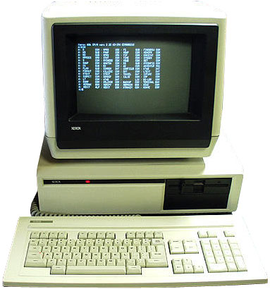
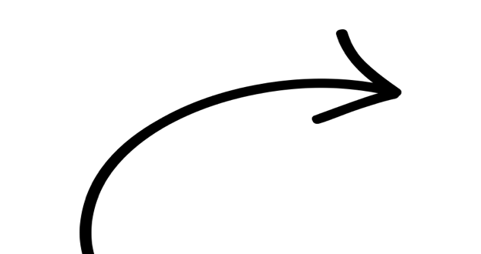
Console - Command Line
No GUI! All text-based (Old computers used to only have a command line!)

Slide 20
GUI - Event Driven Program
In text-based environments, programs determine the order in which things happen
The user can only enter data in the order requested by the program
GUI environment is event-driven
The user determines the order in which things happen
User causes events to take place and the program responds to the events

Slide 21
How do computer graphics get created?

Slide 22
GUI - Event Driven Program
Windows, Mac OS, Linux each have their own GUI systems
GUI libraries are modules that support the GUI (i.e. their functions allow you to interact with your computer’s GUI system)
tkinter is Python’s standard GUI package
Many other GUI libraries are built on top of tkinter!

Slide 23
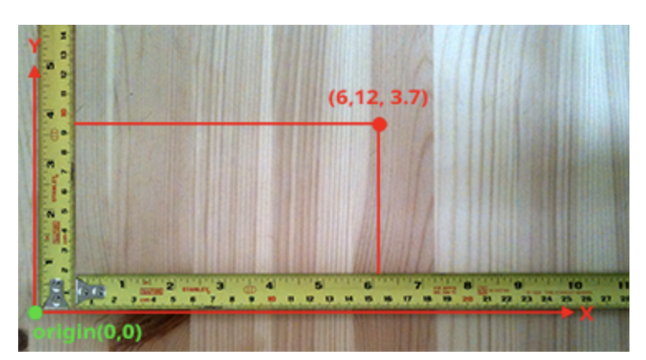
Drawing in Real Life
Draw objects using Cartesian coordinate system

Slide 24
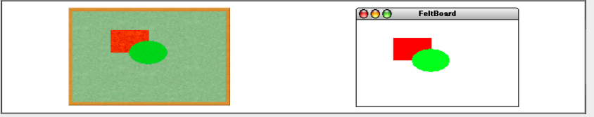
Drawing Computer Graphics
When creating computer graphics we first somehow describe the shape (and the appearance) of objects
Place objects on a background called “Canvas”
Similar to “Felt board” metaphor -
The underlying model is similar to that of a collage in which an artist creates a composition by taking various objects and assembling them on a background canvas.

Slide 25
Canvas
Everything gets drawn on a canvas
In today’s examples, we’ll provide the code for creating the canvas.
x
(0,0)
y

Slide 26
Canvas
0,0
40,20
120,40
CANVAS_HEIGHT
40,120
CANVAS_WIDTH

Slide 27
Canvas
the following main creates a canvas with title with default size
def main():
canvas = Canvas()
)

Slide 28
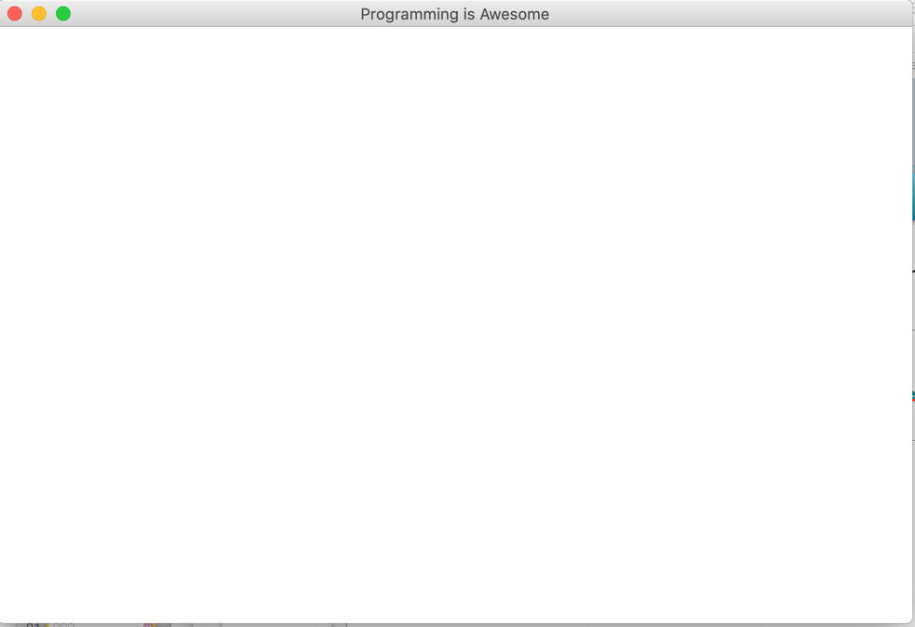
Canvas
the following main creates a canvas with title with default size
def main():
canvas = Canvas()
canvas.set_canvas_title("Programming is Awesome")
)

Slide 29
Canvas
the following main creates a canvas with title with default size
def main():
canvas = Canvas(800, 600)
canvas.set_canvas_title("Programming is Awesome")
)

Slide 30
How do we draw simple shapes?

Slide 31
Drawing Simple Shapes
canvas.create_text()
canvas.create_line()
canvas.create_rectangle()
canvas.create_oval()

Slide 32
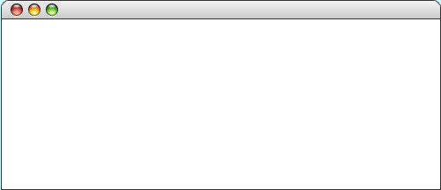
Draw a Rectangle
the following main method displays a blue square
def main():
canvas = Canvas(800, 200)
canvas.set_canvas_title(“Hello Rect”)
)
Hello Rect

Slide 33
Draw a Rectangle
the following main method displays a square
def main():
canvas = Canvas(800, 200)
canvas.set_canvas_title(“Hello Rect”)
)
Hello Rect
800 pixels wide

Slide 34
Draw a Rectangle
the following main method displays a blue square
def main():
canvas = Canvas(800, 200)
canvas.set_canvas_title(“Hello Rect”)
)
Hello Rect
200 pixels tall

Slide 35
Draw a Rectangle
the following main method displays a blue square
def main():
canvas = Canvas(800, 200)
canvas.set_canvas_title(“Hello Rect”)
)
Hello Rect

Slide 36
Draw a Rectangle
the following main method displays a blue square
def main():
canvas = Canvas(800, 200)
canvas.set_canvas_title(“Hello Rect”)
canvas.create_rectangle(20, 20, 100, 100)
)
Hello Rect
20, 20

Slide 37
Draw a Rectangle
the following main method displays a blue square
def main():
canvas = Canvas(800, 200)
canvas.set_canvas_title(“Hello Rect”)
canvas.create_rectangle(20, 20, 100, 100)
)
Hello Rect
100, 100

Slide 38
Draw a Rectangle
the following main method displays a blue square
def main():
canvas = Canvas(800, 200)
canvas.set_canvas_title(“Hello Rect”)
canvas.create_rectangle(20, 20, 100, 100)
)
Hello Rect
Aside: Named Arguments
This argument is named as filled. It allows functions to have arguments which you can ignore if you want a default value.
This is white

Slide 39
Draw a Rectangle
the following main method displays a square
def main():
canvas = Canvas(800, 200)
canvas.set_canvas_title(“Hello Rect”)
canvas.create_rectangle(20, 20, 100, 100)
canvas.mainloop()
Hello Rect
mainloop is a function will loop forever, waiting for events from the user, until the user exits the program

Slide 40
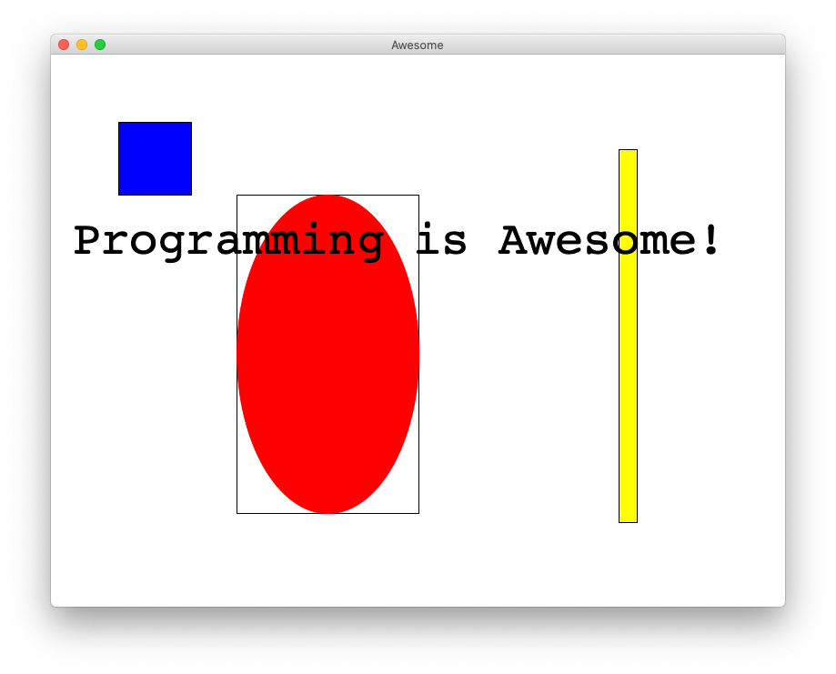
Rectangle, Oval and Text

Slide 41
Drawing Line
canvas.create_line(x1, y1, x2, y2)

Slide 42
Drawing Line
canvas.create_line(x1, y1, x2, y2)
(x1, y1)
(x2, y2)

Slide 43
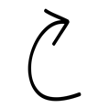
Drawing Oval / Circle
canvas.create_oval(x1, y1, x2, y2)
if x difference same as y difference, then circle
(x1, y1)
(x2, y2)

Slide 44
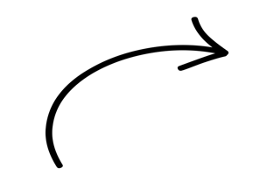
Drawing Text
canvas.create_text(x, y, ’hi’)
hi
(x, y)

Slide 45
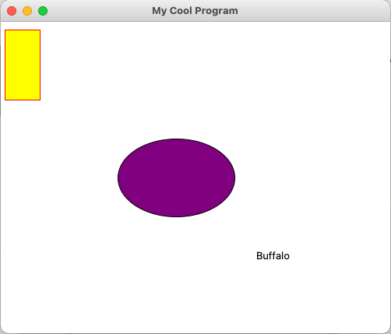
Canvas programming
from graphics import Canvas def main(): canvas = Canvas(500, 400) canvas.set_canvas_title("My Cool Program") rect = canvas.create_rectangle(5, 10, 50, 100) canvas.set_outline_color(rect, "red") canvas.set_fill_color(rect, "yellow") oval = canvas.create_oval(150, 150, 300, 250) canvas.set_fill_color(oval, "purple") canvas.create_text(350, 300, "Buffalo") canvas.mainloop() if __name__ == '__main__': main()

Slide 46
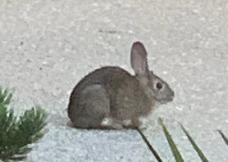
Drawing Image
canvas.create_image(x, y, “name of the file”)
(x, y)

Slide 47
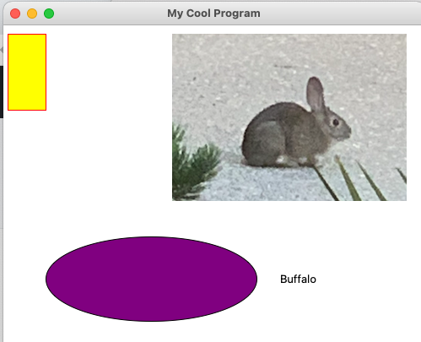
Canvas programming – add image
from graphics import Canvas def main(): canvas = Canvas(500, 400) canvas.set_canvas_title("My Cool Program") rect = canvas.create_rectangle(5, 10, 50, 100) canvas.set_outline_color(rect, "red") canvas.set_fill_color(rect, "yellow") oval = canvas.create_oval(250, 250, 300, 250) canvas.set_fill_color(oval, "purple") canvas.create_text(350, 300, "Buffalo")
# NOTE: need directory images with file frontyardrabbit.png canvas.create_image(200, 10, "images/frontyardrabbit.png") #canvas.create_image(200, 10, "images/burrito.jpg") canvas.mainloop() if __name__ == '__main__': main()

Slide 48
Get Canvas Information
def main():
canvas = Canvas(800, 200)
canvas.set_canvas_title(‘My Wide Program’)
canvas_width = canvas.get_canvas_width()
canvas_height = canvas.get_canvas_height()
#create centered text
canvas.create_text(canvas_width /2, canvas_height/2, ‘Buffalo centered’)

Slide 49
Get Object Information
def main():
canvas = Canvas(800, 200) rect = canvas.create_rectangle(5, 10, 50, 100) print(canvas.get_width(rect) #print 45
print(canvas.get_height(rect) #print 90
print(canvas.get_left_x(rect) #print 5
print(canvas.get_top_y(rect) #print 10

